Slide 2
EXCEPTIONS
Exception is an error event which happens during the execution of a program. It disrupts the normal flow of program.
Database server down, hardware failure, network connection failure
Exception Handling
Overcoming problems during run-time or exceptions.
Java being OOP language wherever an error occurs while executing a statement, creates an exception object and then the normal flow of program halts and JRE tries to find someone who can handle the raised exception
Exception object contains a lot of debugging information such as method hierarchy, line number where the exception occurred, type of exception etc

Slide 3
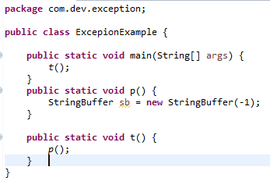
Exception in thread "main" java.lang.NegativeArraySizeException
at java.lang.AbstractStringBuilder.<init>(AbstractStringBuilder.java:68)
at java.lang.StringBuffer.<init>(StringBuffer.java:128)
at com.dev.exception.ExcepionExample.p(ExcepionExample.java:21)
at com.dev.exception.ExcepionExample.t(ExcepionExample.java:25)
at com.dev.exception.ExcepionExample.main(ExcepionExample.java:14)
Method Hierarchy

Slide 4
When the exception occurs in a method, the process of creating an exception object and handling it to run-time environment is called throwing an exception.
Once runtime receives the exception object, it tries to find the handler for the exception. Exception handler is a block of code that can process the exception object.
Logic :Starting the search in the method where error occurred. If not found then it is passed to calling method and so on.
If any exception is found, exception object is passed to handler to process it. The handler is said o be exception handler.
Exception cannot solve compile time errors.
Differentiate exceptions and errors:
Errors are solved using programming skills, errors occur during compile time
Exceptions are solved using exception handler, occurs during run-time

Slide 5
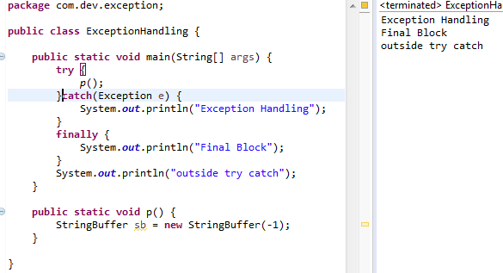
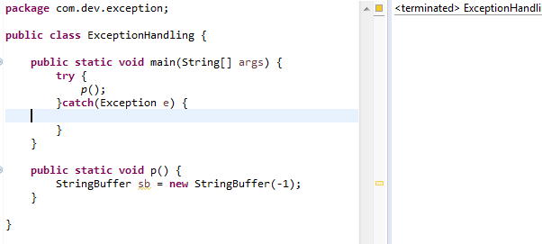
try-catch – used for exception handling our code. Try can have multiple catch bloc and we can have nested try-catch. Catch block should take parameter that should be of type exception. If exception parameter need to be included in catch,then should be written in last catch block .[Try can have arguments.(resources from JDBC)]

Slide 6
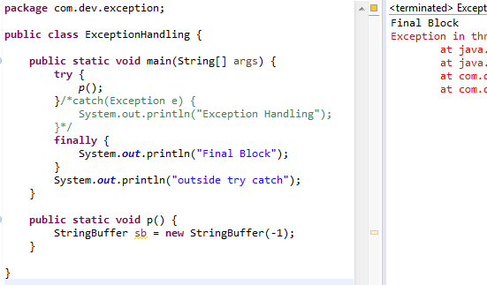
finally → Code written here will be executed even if there is try-catch or any exceptions. Finally can have try catch

Slide 7
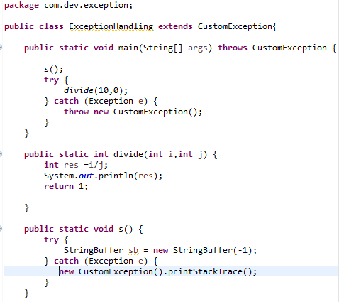
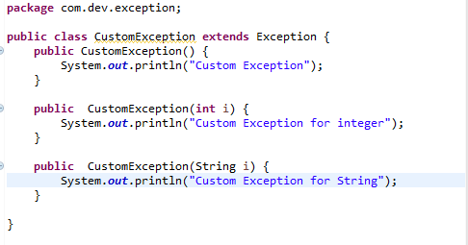
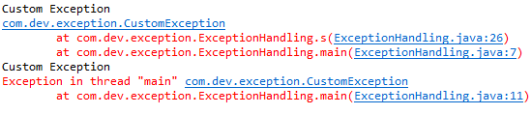
throw – Exception defined or thrown by developer

Slide 8
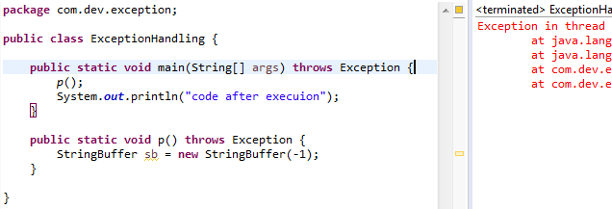
throws –where exception is pre-defined. It is used when calling method is throwing an exception. It tells that a method might thrown an exception
When a method is declared as throws then the method which calls this method should also be declared as throws.
Can provide more than one exception at once.

Slide 9
Java exceptions are hierarchical and inheritance is used to categorize different types of exception.
throwable is a parent class of java exceptions hierarchy and it has two child objects – Error and Exceptions.
Errors : Errors are exceptional scenarios that are out of scope of application and its not possible to anticipate and recover from them.
Ex: Hardware failure,JVM crash or out of memory error.
CHECKED EXCEPTIONS | UNCHECKED EXCEPTIONS
Exception scenarios which can be anticipated are checked Exception.
Provide errors at compilation time | warnings and errors during run-time.
Should be caught and provide useful information to user(will be written in catch).
Try and catch for catch exceptions | try and finally in unchecked Exception.

